Slide 1


Stock market and options

Slide 2
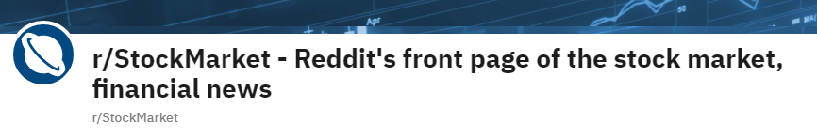

Introduction
Stock Market Subreddit
Options Subreddit

Slide 3
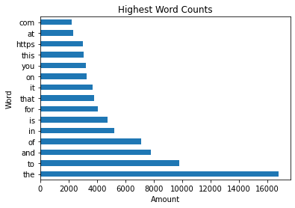
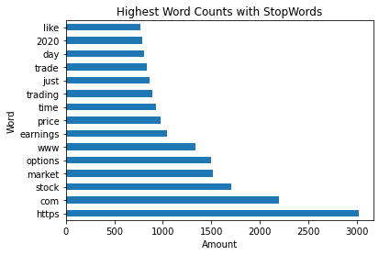
Data Exploration

Slide 4
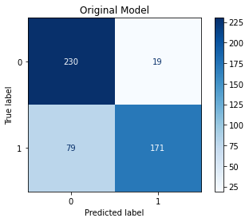
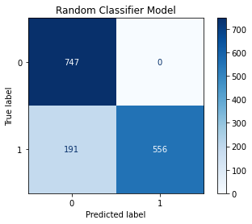
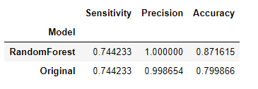
Model Analysis

Slide 5
Conclusions/Recommendations
Is this a good model?
Can one tell the difference between the subreddits just by reading the posts?
Random Forest performs better than Naïve-Bayes Regression Model
Can this model generalize new future posts?

